Slide 1

GROW . INNOVATE . INSPIRE

Slide 2
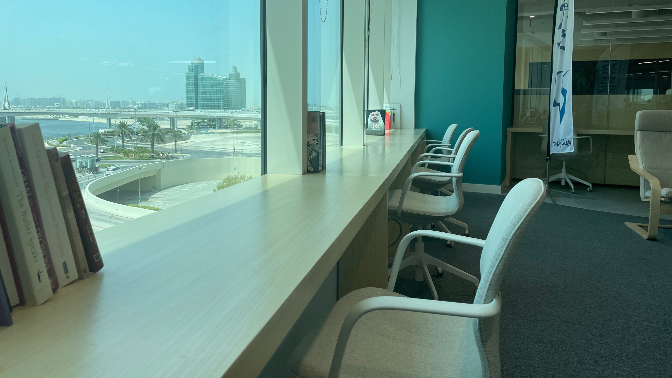

GROW.
GROW.
INNOVATE.
INNOVATE.
INSPIRE.
INSPIRE.

Slide 3

Al Futtaim Leadership Competencies Overview
01
02
WHAT is a Leadership Competency Framework?
WHAT is Al Futtaim Leadership Model?
03
04
Board Game
Leadership Competencies 101
HOW will I apply the Al Futtaim Leadership Competencies?

Slide 4
Al Futtaim Leadership Competencies Overview
01
02
WHAT is a Leadership Competency Framework?
WHAT is Al Futtaim Leadership Model?
03
04
GAME adership Competencies 101
HOW will I Apply Al Futtaim Leadership Competencies Framework?

Slide 5
How Al Futtaim Competencies & Model Drive Success
GROW . INNOVATE . INSPIRE
Notes:
Trainer Notes:
Elevating Leadership: How Al Futtaim Automotive Competencies and Models Drive Success
Opening (1-2 minutes):
Greeting and Introduction: Introduce yourself and your role with warmth and enthusiasm.
Engaging Question: "In today's dynamic automotive industry, what are some key challenges you face as leaders?" (Allow a few seconds for responses and acknowledge answers briefly.)
Background on Al Futtaim Automotive Competencies (1-2 minutes):
Briefly highlight the importance of Al Futtaim Automotive's established competencies in achieving success.
At Al Futtaim Automotive, we take pride in our established competencies. They guide us in delivering exceptional performance and maintaining our leading position in the market."
Purpose of the Session (1-2 minutes):
Introduce the session's focus: Connect the importance of competencies to leadership development and organizations’ success.
Trainer says: Building upon our strong foundation, this session explores how leadership competencies can further strengthen your leadership abilities and contribute to achieving Al Futtaim Automotive's strategic goals."
Introduction to Competency Frameworks and Leadership Models (1-2 minutes):
Provide a clear and concise definition of competency frameworks, mentioning their role in ensuring successful employee performance.
Briefly explain leadership models, emphasizing their role in developing effective leaders.
Trainer Says: Today, we'll delve into two key concepts: competency frameworks and leadership models. Competency frameworks outline the skills and knowledge needed for success, while leadership models provide a roadmap for developing effective leadership behaviors."
Highlight the synergy: Explain how the two concepts work together.
Trainer Says: By integrating leadership models with our established competencies, we can empower individuals to excel in their leadership roles and drive Al Futtaim Automotive's continued success."
Call to Action (1 minute):
Encourage active participation and emphasize the value of shared experiences.
Trainer Says: I encourage you to actively participate and share your insights. Your leadership experiences within Al Futtaim Automotive are invaluable, and your interaction will enrich our discussion and learning."
Closing (30 seconds):
Briefly thank participants for their time and attention.
Transition smoothly into the next section of your presentation.

Slide 6

“A recent industry trend survey of CEOs found that only 11% of organizations report having a strong enough bench to fill leadership roles”
-CCL, 2022
Notes:
Trainer Note: Introduction Transparency
Important to highlight in the introduction:
Acknowledge Al-Futtaim Automotive's ongoing journey: Briefly mention that Al-Futtaim Automotive is actively working on raising awareness and knowledge of the established competencies and their various applications.
Set expectations and transparency: Be transparent about the ongoing process of embedding these competencies into employee lifecycle touchpoints, acknowledging that this process is still under development.
Trainer says:
"As you know, Al-Futtaim Automotive is committed to excellence, and a crucial part of that commitment is our established set of competencies. Today, we'll be exploring these competencies in more detail. It's important to acknowledge that we're currently on a journey to both raise awareness and knowledge of these competencies and their applications across various aspects of our work. We're also actively working on embedding them into different touchpoints throughout the employee lifecycle. While this process is ongoing, today's session will equip you with a strong understanding of these competencies and their potential to empower your leadership journey within Al-Futtaim Automotive."

Slide 7
“Connecting organization core values and beliefs with the leader’s personal motivators reinforce their passion and ability to influence others.”
- Deloitte, Leadership Development Solutions: Market Primer, 2020
Notes:
Trainer Note: Aligning Values for Effective Leadership
Objective: Emphasize the importance of aligning personal values with organizational values for effective leadership.
Talking points:
Introduce the quote: Briefly mention the source and year of the quote.
Explain the key message: Paraphrase the quote in simpler terms, highlighting the connection between personal and organizational values for leaders.
"This quote from Deloitte's 2020 'Leadership Development Solutions: Market Primer' emphasizes the crucial link between a leader's personal values and the organization's core values and beliefs."
Benefits of alignment: Explain the positive impact of this alignment.
Reinforced passion: Mention how alignment strengthens a leader's passion and commitment.
Enhanced influence: Explain how it empowers leaders to influence others more effectively.
Application within Al-Futtaim: Briefly connect the concept to Al-Futtaim Automotive.
"By fostering an environment where personal values resonate with Al-Futtaim Automotive's core values, we empower our leaders to be passionate and influential, ultimately contributing to a more engaged workforce and achieving our strategic goals."
Trainer says:
"As we explore the aspects of our leadership competency framework, it's vital to consider this insightful quote from Deloitte's 2020 'Leadership Development Solutions: Market Primer.' It emphasizes that when a leader's personal values and motivations align with the organization's core values and beliefs, their passion and ability to influence others are significantly strengthened. This alignment empowers leaders to not only be genuinely invested in their roles but also inspire and motivate their teams, fostering a positive and productive work environment. As we move forward, let's remember this crucial element and explore how our leadership competency framework can further cultivate leaders who embody both personal and organizational values, propelling Al-Futtaim Automotive towards continued success."

Slide 8
“The research consistently highlights the correlation between effective leadership and business success, including factors such as financial performance and employee engagement.”
- Development Dimensions International (DDI): The Global Leadership Forecast
Notes:
Trainer Note: enhancing business sucess
Objective: Emphasize the role of effective leadership in achieving business success
Talking points:
Introduce the quote: Briefly mention the source and year of the quote.
Explain the key message: Paraphrase the quote in simpler terms, highlighting the connection between personal and organizational values for leaders.
"This quote from The Global Leadership Forecast emphasizes the crucial link between a leader’s effectiveness and business success”
Application within Al-Futtaim: Briefly connect the concept to Al-Futtaim Automotive.
Connect it with the below similar note
Studies often show a correlation between strong leadership competencies and positive organizational performance. (Harvard Business Review)
One of the main areas of success is employee satisfaction and engagement (reflect as well with the below quote
Companies that actively implement training and mentoring initiatives to develop leadership competencies are 3.4 times more likely to be rated as a best place to work. (HR Trends)

Slide 9


What is a Leadership Competency Framework?
A leadership competency framework is a structured and comprehensive set of skills, behaviors, and attributes that define effective leadership within an organization. It serves as a guide to identify, develop, and assess the leadership qualities required for success in a specific context or industry. The framework typically outlines the key competencies or capabilities that leaders at various levels should possess to drive organizational performance and achieve strategic goals.
Notes:
Trainer Note:
What Is A Leadership Competency Framework?
Talking points:
Briefly acknowledge the executives' existing knowledge of competencies within Al-Futtaim Automotive.
Define "leadership competency framework" in clear and concise language, emphasizing its role as a structured guide.
Highlight the key elements of a framework: skills, behaviors, and attributes.
Explain the purpose of the framework: identifying, developing, and assessing effective leadership.
Briefly mention the context-specific nature of leadership competencies, emphasizing the importance of relevance to Al-Futtaim Automotive.
Trainer Says: . As many of you are already familiar with our established competencies at Al-Futtaim Automotive, today we'll delve deeper into how leadership competency frameworks can further enhance our leadership development journey. A leadership competency framework is essentially a structured set of skills, behaviors, and attributes that define what it means to be an effective leader within our specific organization. This framework serves as a valuable guide for identifying the qualities needed to succeed in your leadership roles, fostering development opportunities, and ultimately achieving our strategic goals."

Slide 10
AL FUTTAIM LEADERSHIP COMPETENCIES
Awareness I Knowledge I Integration
GROW . INNOVATE . INSPIRE
Notes:
The leadership competencies are not new to Al Futtaim Group. There were LCs since 2017/2018, however they have been reviewed, revamped and relaunched in 2022. We are not on a quest to raise awareness and knowledge around them and in parallel work on embedding the competencies in our key employee lifecycle touchpoints (including recruitment, performance mgt, development, and succession planning). This is a journey we’re on.

Slide 11






LEADERSHIP COMPETENCY FRAMEWORK BENEFITS
Optimal Leadership Culture
Performance Excellence
Adaptability & Resilience
01
03
05
02
04
06
Engaged Employees
Future Readiness
Business Success
GROW . INNOVATE . INSPIRE
Notes:
Companies that actively implement training and mentoring initiatives to develop leadership competencies are 3.4 times more likely to be rated as a best place to work. (HR Trends)
Having Motivated and Engaged employees are a direct impact of having effective leaders in the organization who are skilled and competent.
According to Gallup's State of the Global Workplace report, organizations with engaged employees outperform those without by a significant margin.
Deloitte's annual Human Capital Trends report often emphasizes the critical role of leadership in navigating the challenges of the modern workforce. The 2021 report, for instance, highlights the need for leaders who can be resilient, empathetic, and adaptable.
The Global Leadership Forecast is a biennial study conducted by DDI (Development Dimensions International) and The Conference Board. The research consistently highlights the correlation between effective leadership and business success, including factors such as financial performance and employee engagement.

Slide 12
LEADERSHIP COMPETENCY FRAMEWORK BENEFITS
That’s what inspired us at Al-Futtaim to revamp our Leadership Competency Framework.
Notes:
The leadership competencies are not new to Al Futtaim Group. There were LCs since 2017/2018, however they have been reviewed, revamped and relaunched in 2022. We are not on a quest to raise awareness and knowledge around them and in parallel work on embedding the competencies in our key employee lifecycle touchpoints (including recruitment, performance mgt, development, and succession planning). This is a journey we’re on.

Slide 13
Al Futtaim Leadership Competencies Overview
01
02
WHAT is Leadership Competency Framework?
WHAT is Al Futtaim Leadership Model?
03
04
GAME Leadership Competencies 101
HOW will I Apply Al Futtaim Leadership Competencies Framework?

Slide 14
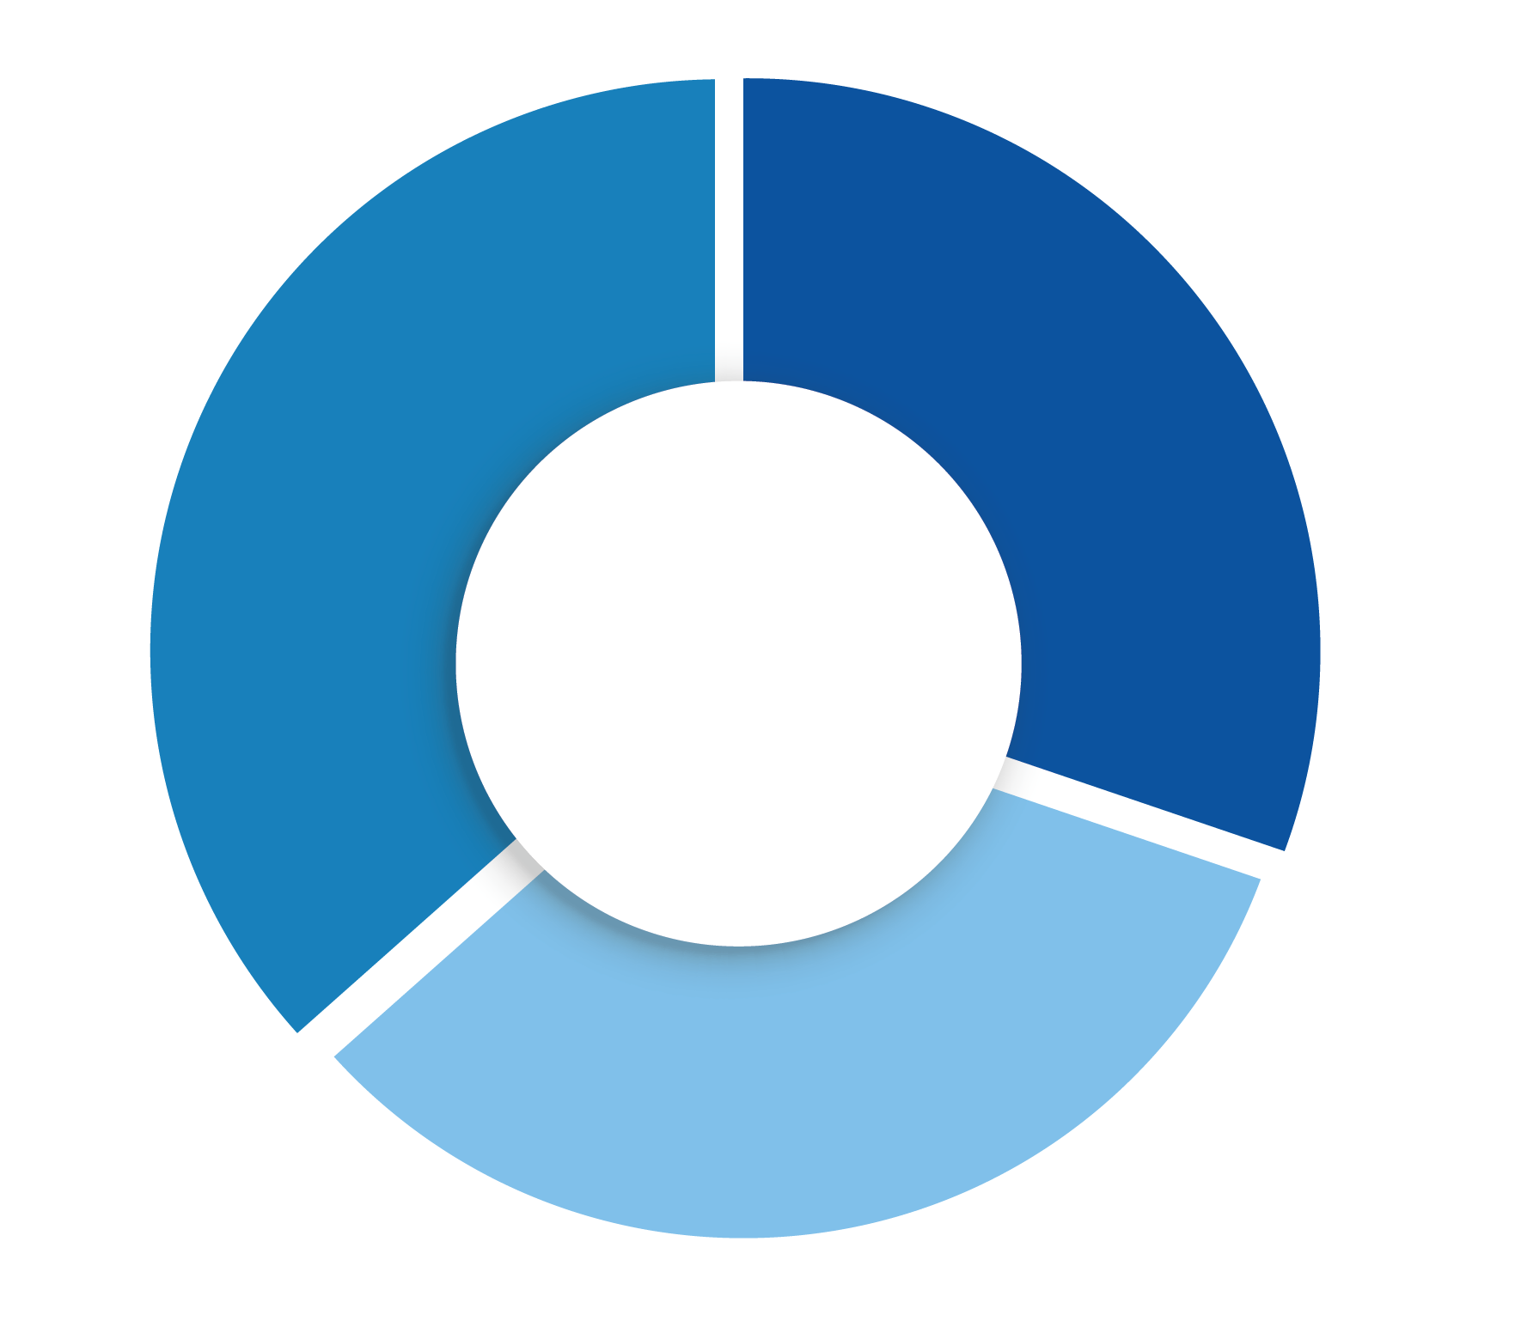
OUR LEADERSHIP MODEL – 3 Pillars
ACTIVATE INNOVATION
GROW YOUR BUSINESS
Customer Centricity
Future Proofing
Change Agile
Commercial Drive
Goal Driven
Managing Complexity
INSPIRE OUR PEOPLE
Influence and Challenge Engaging Leadership
GROW . INNOVATE . INSPIRE
Notes:
Objective: Introduce Al-Futtaim Automotive's leadership model and its core pillars.
Talking points:
Briefly introduce the slide title: "Our Leadership Model: 3 Pillars."
Point to the image and acknowledge the three pillars: Authenticity, Commitment, and Customer Focus.
Briefly explain each pillar and its significance in the context of Al-Futtaim Automotive's leadership philosophy.
Trainer Says: "As you can see on the slide, our leadership model is anchored by three core pillars: Authenticity, Commitment, and Customer Focus. These pillars represent the fundamental values and behaviors that guide our leadership approach at Al-Futtaim Automotive. Let's start by exploring the first pillar, Authenticity. Authenticity is about being true to yourself and your values, leading with transparency and genuineness. This fosters trust and strengthens relationships within our teams. We then move on to Commitment, which represents dedication and perseverance in achieving our goals. Committed leaders inspire and motivate others, fostering a culture of ownership and accountability. Finally, Customer Focus emphasizes the importance of prioritizing our customers' needs and exceeding their expectations. By keeping the customer at the center of everything we do, we can ensure long-term success and sustainable growth."

Slide 15

8 LEADERSHIP COMPETENCIES
FOR SUCCESS
Customer Centricity
Commercial Drive
Commercial
Drive
Customer Centricity
Customer centricity
Goal Driven
We value Respect
Future Proofing
Goal Driven
Future Proofing
We value Integrity
We value Collaboration
Change Agile
We value Excellence
Change Agile
Managing Complexity
Managing Complexity
Managing Complexity
Change Agile
Developing talents
Influence
& Challenge
Engaging Leadership
Engaging Leadership
Influence & Challenge
GROW . INNOVATE . INSPIRE

Slide 16
8 LEADERSHIP COMPETENCIES
FOR SUCCESS
Commercial Drive
An entrepreneurial mindset; recognize and seize opportunities; take measured risk into account. Focus on initiatives that drive business advancement.
Commercial
Drive
Customer centricity
We value Respect
We value Integrity
We value Collaboration
Change Agile
We value Excellence
Managing Complexity
Developing talents
GROW YOUR BUSINESS

Slide 17
8 LEADERSHIP COMPETENCIES
FOR SUCCESS
Customer centricity
Goal Driven
Results focused, delivering stretching outcomes both as an individual and through teams, with no fear of failure, showing enthusiasm and self-motivation to perform.
We value Respect
Goal Driven
We value Integrity
We value Collaboration
Change Agile
We value Excellence
Managing Complexity
Developing talents
GROW YOUR BUSINESS

Slide 18
8 LEADERSHIP COMPETENCIES
FOR SUCCESS
Customer centricity
We value Respect
We value Integrity
We value Collaboration
Managing Complexity
We value Excellence
Change Agile
Confident managing the various challenges that our increasingly complex workplace and roles demand: global, digital, competitor, consumer, employees.
Managing Complexity
Managing Complexity
Developing talents
GROW YOUR BUSINESS

Slide 19
8 LEADERSHIP COMPETENCIES
FOR SUCCESS
Customer centricity
We value Respect
We value Integrity
We value Collaboration
Change Agile
We value Excellence
Managing Complexity
Developing talents
Influence
& Challenge
Influence & Challenge
Create positive momentum by persuading the organization, demonstrating personal courage, and an ability to durably align different opinions.
INSPIRE OUR PEOPLE

Slide 20
8 LEADERSHIP COMPETENCIES
FOR SUCCESS
Customer centricity
We value Respect
We value Integrity
We value Collaboration
Change Agile
We value Excellence
Managing Complexity
Developing talents
Engaging Leadership
Engaging Leadership
Inspire people through a compelling vision fueled by a culture of support, enablement and empathy. Building a safe environment for employees to be at their best, feel included and valued.
INSPIRE OUR PEOPLE

Slide 21
8 LEADERSHIP COMPETENCIES
FOR SUCCESS
Customer centricity
We value Respect
We value Integrity
We value Collaboration
Change Agile
Anticipate and lead change: adapt actions, accordingly, demonstrate tolerance for ambiguity; have a comfort with uncertainty. Shows flexibility in adjusting own views and objectives in order to achieve a shared goal.
Change Agile
We value Excellence
Change Agile
Managing Complexity
Developing talents
ACTIVATE INNOVATION

Slide 22
8 LEADERSHIP COMPETENCIES
FOR SUCCESS
Customer centricity
Future Proofing
Demonstrate an unquestionable willingness to learn everyday, un-learn old approaches, and partner with others to assist them in doing the same.
We value Respect
Future Proofing
We value Integrity
We value Collaboration
Change Agile
We value Excellence
Managing Complexity
Developing talents
ACTIVATE INNOVATION

Slide 23
8 LEADERSHIP COMPETENCIES
FOR SUCCESS
Customer Centricity
Works to delight internal and external customers with exceptional service and products, acting as a trusted advisor.
Customer centricity
Customer Centricity
We value Respect
We value Integrity
We value Collaboration
Change Agile
We value Excellence
Managing Complexity
Developing talents
ACTIVATE INNOVATION

Slide 24
8 LEADERSHIP COMPETENCIES
FOR SUCCESS
Customer Centricity
Commercial Drive
Works to delight internal and external customers with exceptional service and products, acting as a trusted advisor.
An entrepreneurial mindset; recognize and seize opportunities; take measured risk into account. Focus on initiatives that drive business advancement.
Commercial
Drive
Customer Centricity
Customer centricity
Future Proofing
Goal Driven
Demonstrate an unquestionable willingness to learn everyday, un-learn old approaches, and partner with others to assist them in doing the same.
Results focused, delivering stretching outcomes both as an individual and through teams, with no fear of failure, showing enthusiasm and self-motivation to perform.
We value Respect
Goal Driven
Future Proofing
We value Integrity
We value Collaboration
Change Agile
Managing Complexity
Anticipate and lead change: adapt actions, accordingly, demonstrate tolerance for ambiguity; have a comfort with uncertainty. Shows flexibility in adjusting own views and objectives in order to achieve a shared goal.
Change Agile
We value Excellence
Change Agile
Confident managing the various challenges that our increasingly complex workplace and roles demand: global, digital, competitor, consumer, employees.
Managing Complexity
Managing Complexity
Developing talents
Influence
& Challenge
Engaging Leadership
Influence & Challenge
Engaging Leadership
Create positive momentum by persuading the organization, demonstrating personal courage, and an ability to durably align different opinions.
Inspire people through a compelling vision fueled by a culture of support, enablement and empathy. Building a safe environment for employees to be at their best, feel included and valued.
GROW . INNOVATE . INSPIRE

Slide 25
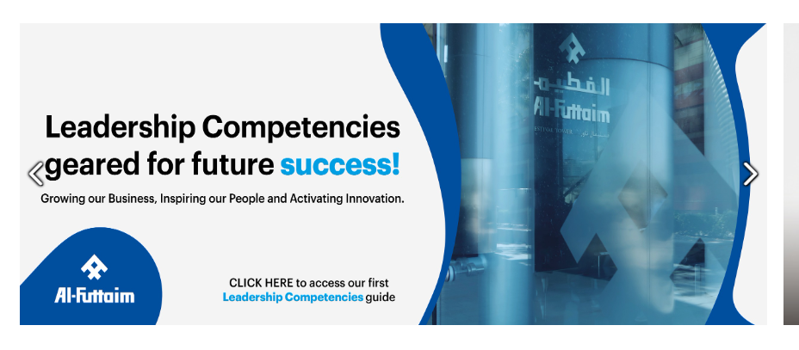
Where can you find the Leadership Competencies?
Step 1
Login to AlFuttaim intranet OR Click here to login
Step 2
Click on the ‘arrow’ of the carousel till you see Leadership Competencies 101
Step 3
Click on the banner of Leadership Competencies 101
Step 4
It will take to the page of Leadership Competencies
GROW . INNOVATE . INSPIRE
Notes:
Before immersing ourselves in appreciating the leadership competencies and appreciating real life situations where utilizing them come to live, this is where you can find all the details of the leadership model, the 8 competencies and all the proficiency levels associated with the different leader

Slide 26
Al Futtaim Leadership Competencies Overview
01
02
WHAT is Leadership Competency Framework?
WHAT is Al Futtaim Leadership Model?
03
04
Board Game
Leadership Competencies 101
HOW will I Apply Al Futtaim Leadership Competencies Framework?

Slide 27
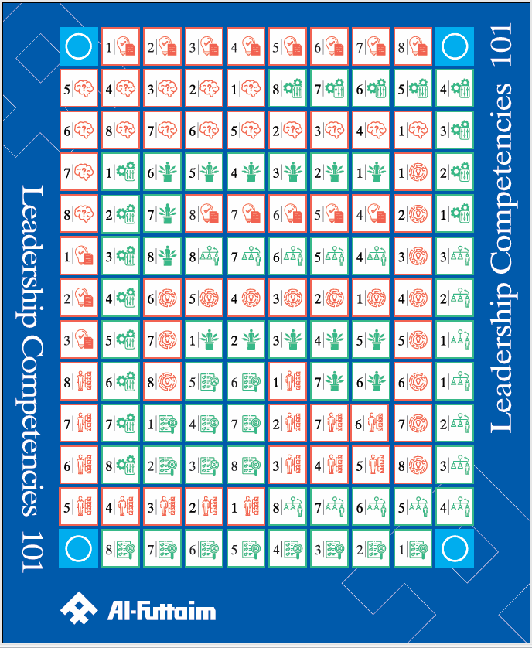


LEADERSHIP COMPETENCIES 101

Slide 28
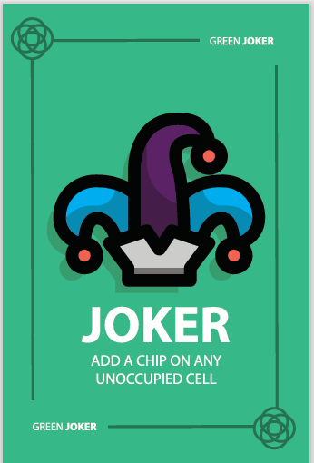
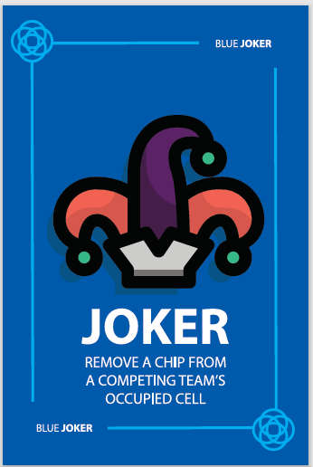
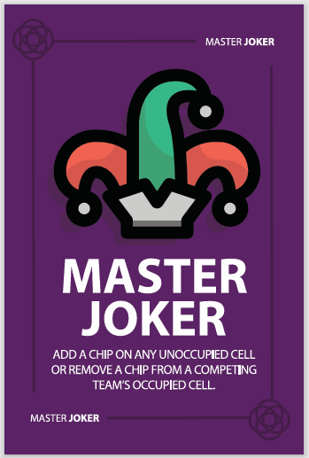
LEADERSHIP COMPETENCIES 101 – GAME COMPONENTS
Colored Tokens for each team
One Set of Cards
Game Board

Slide 29
LEADERSHIP COMPETENCIES 101 – CARDS SAMPLE
Green Joker: Add a chip on any unoccupied cell.
Blue Joker: Remove a chip from a competing team’s occupied cell.
Master Joker: Add a chip on any unoccupied cell OR remove a chip from a competing team’s occupied cell.

Slide 30
8 LEADERSHIP COMPETENCIES
FOR SUCCESS
Customer Centricity
Commercial Drive
Works to delight internal and external customers with exceptional service and products, acting as a trusted advisor.
An entrepreneurial mindset; recognize and seize opportunities; take measured risk into account. Focus on initiatives that drive business advancement.
Commercial
Drive
Customer Centricity
Customer centricity
Future Proofing
Goal Driven
Demonstrate an unquestionable willingness to learn everyday, un-learn old approaches, and partner with others to assist them in doing the same.
Results focused, delivering stretching outcomes both as an individual and through teams, with no fear of failure, showing enthusiasm and self-motivation to perform.
We value Respect
Goal Driven
Future Proofing
We value Integrity
We value Collaboration
Change Agile
Managing Complexity
Anticipate and lead change: adapt actions, accordingly, demonstrate tolerance for ambiguity; have a comfort with uncertainty. Shows flexibility in adjusting own views and objectives in order to achieve a shared goal.
Change Agile
We value Excellence
Change Agile
Confident managing the various challenges that our increasingly complex workplace and roles demand: global, digital, competitor, consumer, employees.
Managing Complexity
Managing Complexity
Developing talents
Influence
& Challenge
Engaging Leadership
Influence & Challenge
Engaging Leadership
Create positive momentum by persuading the organization, demonstrating personal courage, and an ability to durably align different opinions.
Inspire people through a compelling vision fueled by a culture of support, enablement and empathy. Building a safe environment for employees to be at their best, feel included and valued.
GROW . INNOVATE . INSPIRE

Slide 31
Al Futtaim Leadership Competencies Overview
01
02
WHAT is Leadership Competency Framework?
WHAT is Al Futtaim Leadership Model?
03
04
GAME Leadership Competencies 101
HOW will I apply Al Futtaim Leadership Competencies ?

Slide 32





HOW WILL WE LEVERAGE THE LEADERSHIP COMPETENCY MODEL ?
Recruitment
Performance Management
Development Planning
(Self/Team)
Succession Planning
& Career Growth

Slide 33



HOW TO READ THE LEADERSHIP COMPETENCIES FRAMEWORK ?
Each of the 8 competencies have been expanded into specific Leadership Behaviors across 3 proficiency levels:
Level 1 (Bands G & H)
Level 2 (Bands I & J)
Level 3 (Bands K & L)
This provides transparency of behavioral and capability expectation as employees grow into more senior leadership roles.
GROW . INNOVATE . INSPIRE

Slide 34
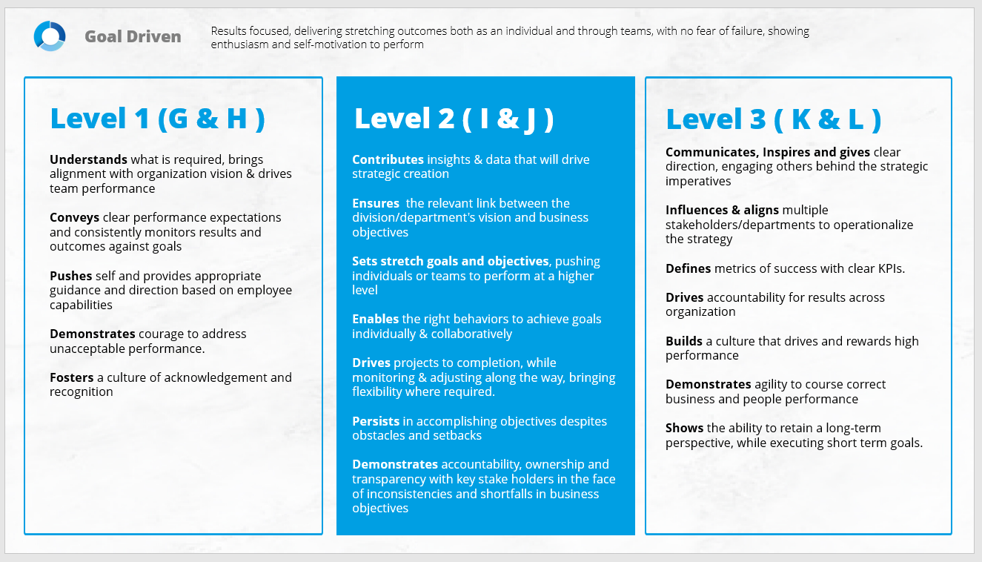
HOW TO READ THE LEADERSHIP COMPETENCIES FRAMEWORK ?
Competency Definition
Competency Name
Leadership Model Pillar
Proficiency Level
Leadership Behavioral Anchors
GROW . INNOVATE . INSPIRE

Slide 35

LET’S RECAP
Notes:
https://view.genial.ly/65b31eee2eaa93001483f4be/interactive-content-al-futtaim-leadership-competencies-101-recap-game

Slide 36
Notes:
FEEDBACK

Slide 37
THANK YOU!

